Slide 1
Emergency Route Planning Using A* Algorithm and Geospatial Data
Presented By
Krushna Paul (612203101)
Tejas Kumare(612203104)

Slide 2
Introduction
Objective:
To develop a web application that calculates the shortest path from a user-
selected location to the nearest emergency hospital.
Key Features:
Uses real-world road networks from OpenStreetMap (OSM).
Implements the A* algorithm for route optimization.
Visualizes results on an interactive map with Folium.

Slide 3
Data Sources
Hospital Data:
CSV file containing hospital details in Pune (filtered for emergency services).
Geometry data for locations in WKT format.
Road Network:
Extracted from OpenStreetMap using OSMNx.

Slide 4
Key Technologies Used
Flask: Web framework for backend functionality.
OSMNx: To retrieve road networks.
NetworkX: For graph-based calculations and pathfinding.
Folium: To visualize maps and routes interactively.
Geopy: To calculate geodesic distances.
Pandas: To manage hospital data.

Slide 5
A* Algorithm Overview
Definition: A graph traversal and pathfinding algorithm.
Components:
Graph: Nodes (road intersections) and edges (roads).
Heuristic: Geodesic distance between nodes.
Priority Queue: Keeps track of the next node to visit based on cost.
Steps:
Initialize the priority queue with the start node.
Expand the least-cost node.
Update costs and continue until the goal node is reached.
Reconstruct the path.

Slide 6
Application Workflow
User Input:
Select a location from the dropdown menu.
Hospital Filtering:
Identify the nearest emergency hospital using geodesic distance.
Road Network Analysis:
Map start and destination locations to nearest OSM nodes.
Pathfinding:
Use the A* algorithm to find the shortest path.
Visualization:
Plot the path and emergency hospitals on an interactive map.

Slide 7
Implementation Details
Backend :
Flask handles user requests and renders templates.
A* algorithm is implemented with NetworkX and geopy.
Frontend :
Folium map embedded in the web app.
Data :
Emergency hospitals filtered from a CSV file.
Road network fetched dynamically from OSMNx.

Slide 8
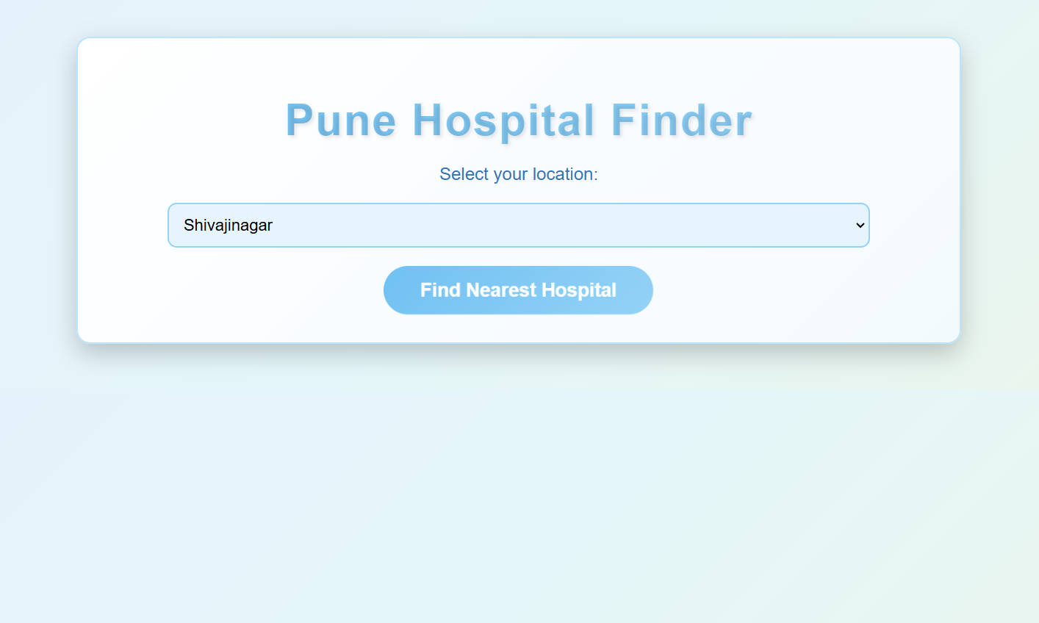
Example : Selecting the desired location to find the nearest hospital

Slide 9
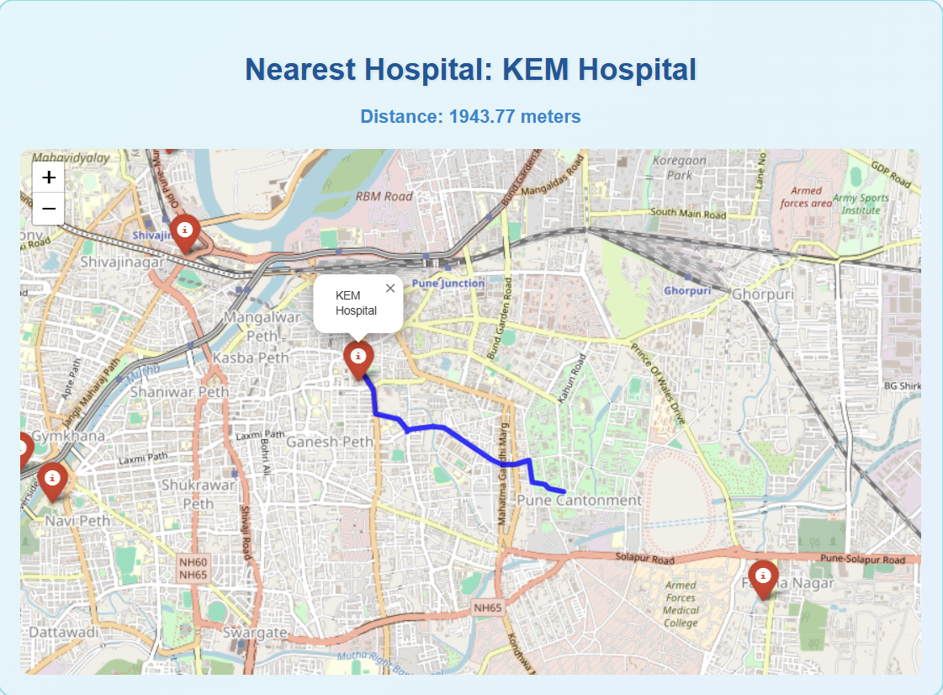
Output : We get the nearest hospital nearby

Slide 10
Challenges and Solutions
Challenge 1: Managing large OSM data for Pune.
Solution: Limit to "drive" network type for optimal performance.
Challenge 2: Accurate geospatial calculations.
Solution: Use geopy for precise distance measurements.
Challenge 3: Efficient route calculation.
Solution: Optimize A* implementation with heuristic tuning.

Slide 11
Conclusion
Summary:
Developed a user-friendly application for emergency routing.
Integrated multiple technologies to achieve real-world results.
Future Work:
Expand to include traffic and real-time data.
Add support for other transport modes (walking, cycling).

